Slide 1
Improving Language Understanding
by Generative Pre-Training
Mica Haney
Himanshu Sharma
Fanjie Ye

Slide 2
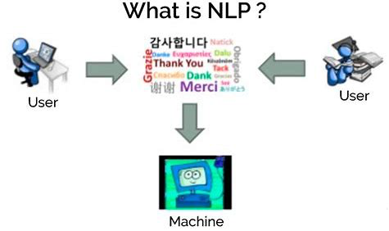
Outline
Introduction and Related Work
Framework
1. Unsupervised Pre-Training
2. Supervised Fine-Tuning
Experiment Results and Evaluation

Slide 3
Introduction
Although it’s important for NLP tasks to reduce the dependency on supervised learning, most deep learning methods require substantial amounts of manually labeled data.
This paper proposed a method which combines unsupervised and supervised learning to learn a universal representation. They achieved it by two-stage training procedure.
This method is based on the Transformer model which has an excellent performance on various NLP tasks and evaluated on four types of NLP tasks. It showed a great improvement on these.

Slide 4
Three Questions
What problem does this paper try to solve?
Why is this problem important for NLP?
How does this method work for solving it?

Slide 5
Related Work
Semi-supervised learning for NLP:
Phrase-level or sentence-level embeddings, which can be trained using an unlabeled corpus, have been used to encode text into suitable vector representations for various target tasks (higher-level semantics than word-level information).
Unsupervised pre-training:
The goal is to find a good initialization point instead of modifying the supervised learning objective.
Auxiliary training objects:
Adding auxiliary unsupervised training objectives is an alternative form of semi-supervised learning.

Slide 6
Framework
Two stages of training:
Unsupervised Pre-Training
Supervised Fine-Tuning

Slide 7
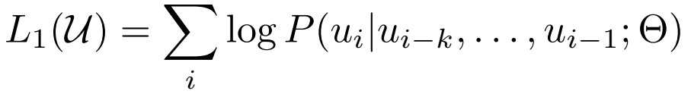
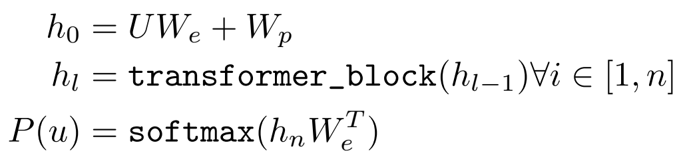
Stage 1: Unsupervised Pre-Training
Use multi-layer Transformer decoder for language modeling.
Applies multi-head self-attention on input.
Position-wise feed forward layers for output. Where: U = Vector of Token W_{e} = Token Embedding Matrix n = Number of Layers W_{p} = Position Embedding Matrix

Slide 8
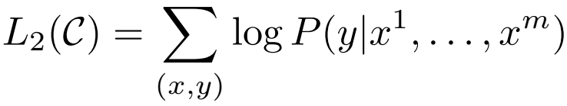

Stage 2: Supervised Fine-Tuning
Training using label dataset.
Activation from stage 1 fed into linear output layer.
Auxiliary language modeling helps learning by:
Improving Generalization.
Accelerating Convergence.
Optimize objective with weight λ.

Slide 9
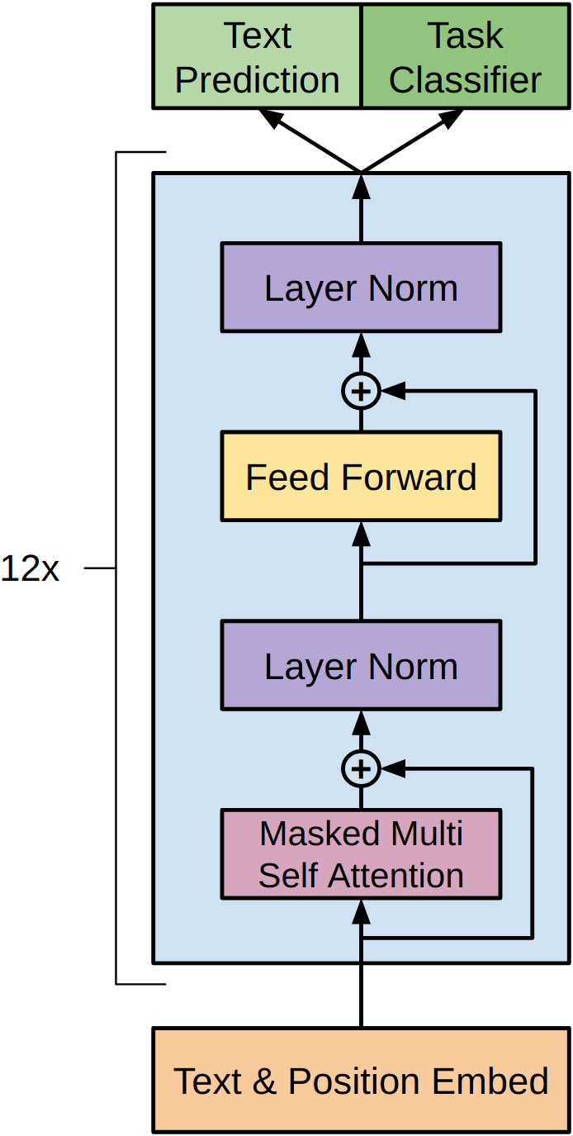
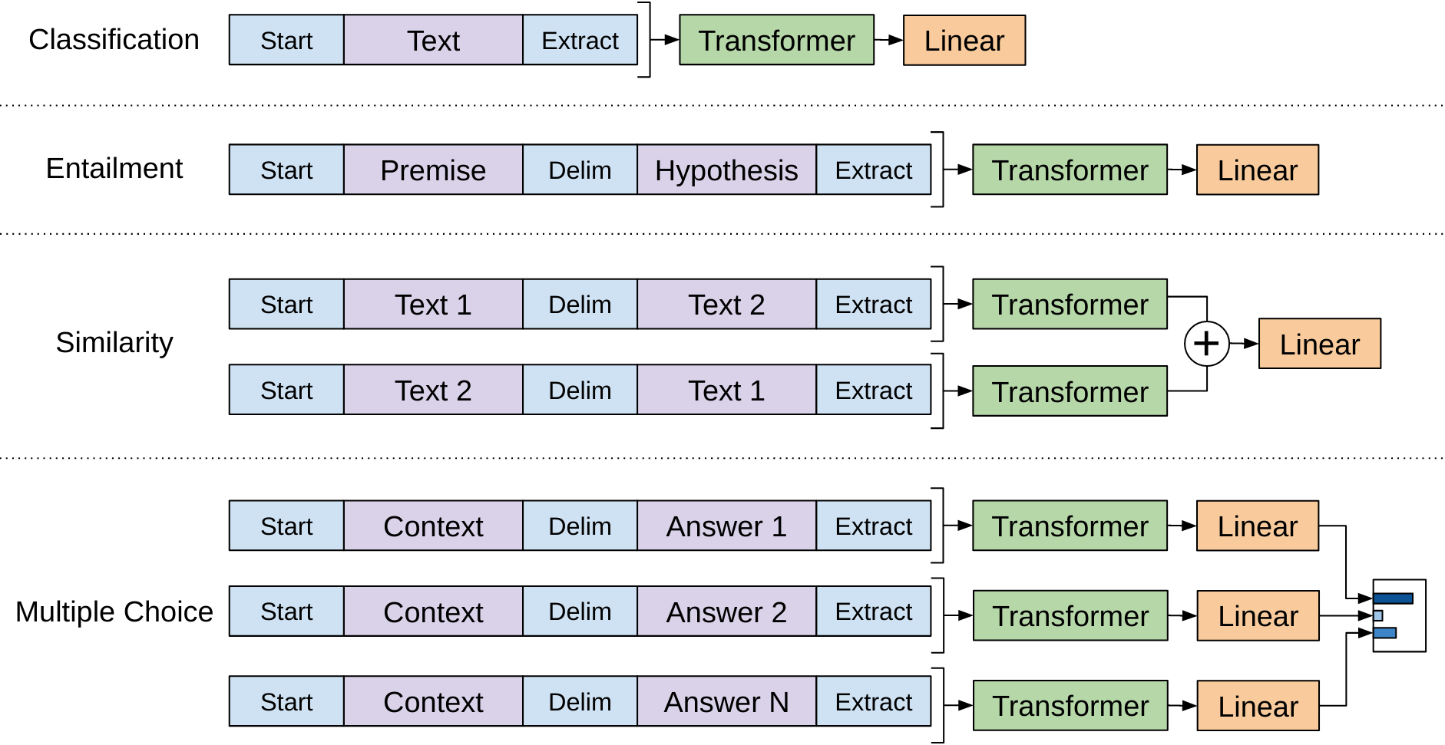
Architecture
Transformer
Fine-Tuning

Slide 10
Task-Specific Input Transformer
Textual entailment
Concatenate premise & hypothesis token($) seq. with delimiter in between..
Similarity
Input seq. contain sentence no inherent oderings and process each independently.
Sequence representations are added element-wise.
Q&A and Commonsense Reasoning
Concatenate context document and possible answer with delimiter in between.
Seq. processed independently and then normalized using softmax.

Slide 11
Experiments and Analysis
Results were evaluated over four different tasks:
Natural Language Inference
Question Answering
Semantic Similarity
Classification
Results were obtained with models trained over the BooksCorpus dataset.

Slide 12
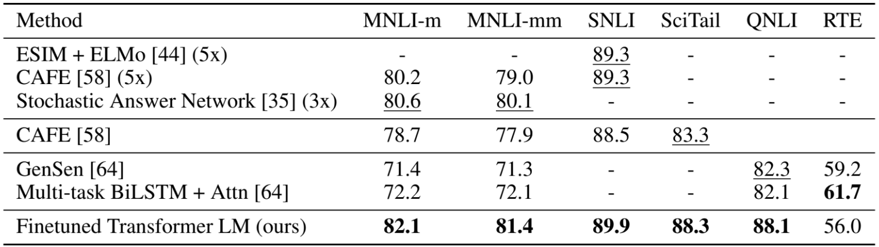
Natural Language Inference
NLI is the task of determining whether a pair of sentences are entailed - if the hypothesis sentence can be inferred from the premise sentence.

Slide 13
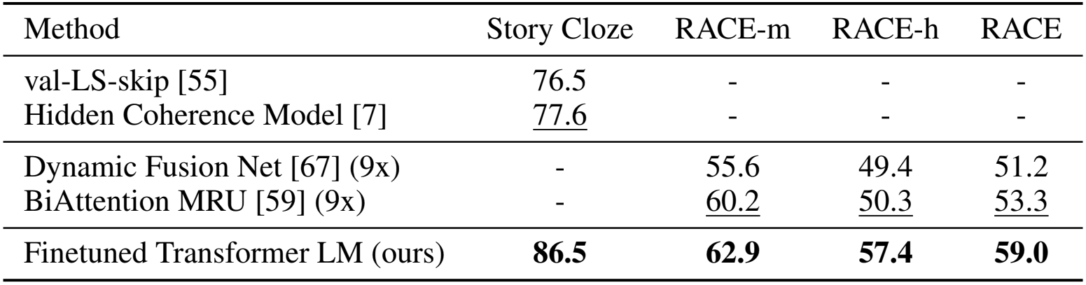
Question Answering
Question answering is the task of selecting the answer to a question out of multiple presented answers.

Slide 14
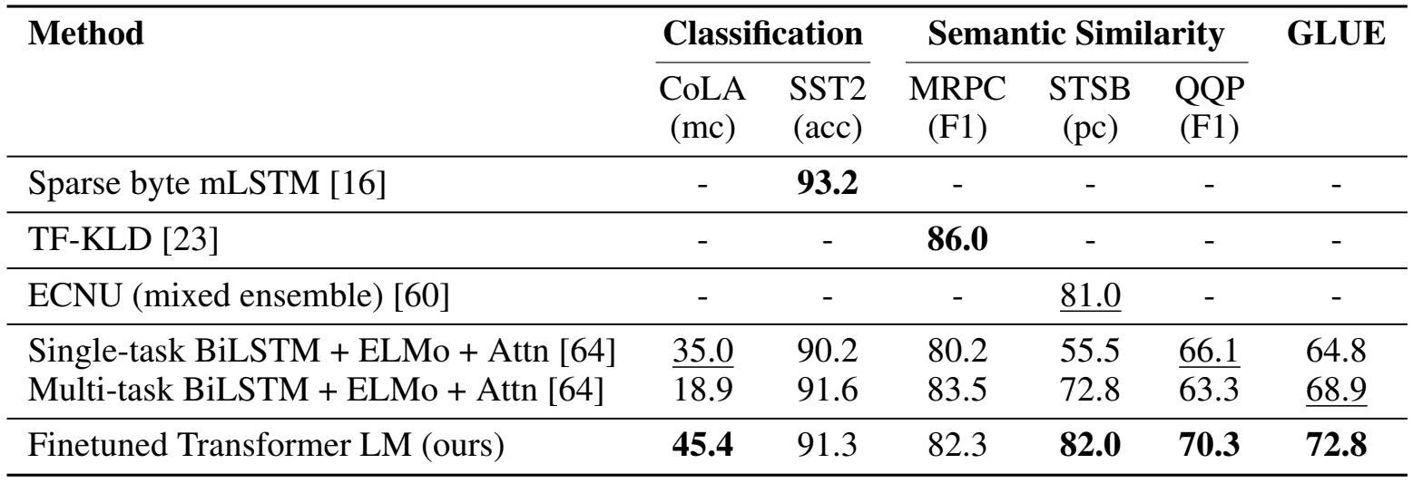
Semantic Similarity and Classification
Semantic similarity is the task of determining if two sentences are roughly similar. Classification (in this paper) is the task of determining if a sentence is grammatical or not.

Slide 15
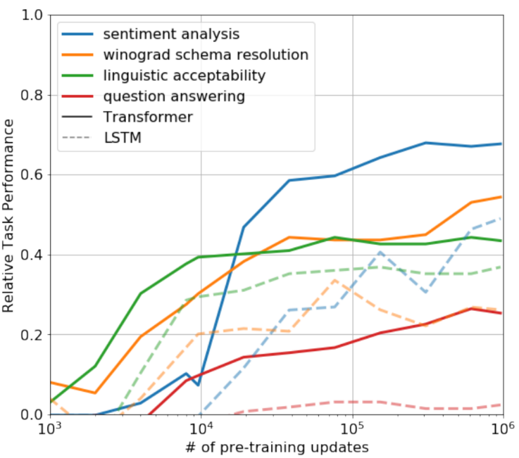
Zero-Shot Analysis
Zero-shot learning is the task of taking a supervised-training model, and testing its performance on completely unseen data.
The stable, steady increase in performance indicates that the Transformer model learns a wide variety of task-relevant functionality.

Slide 16
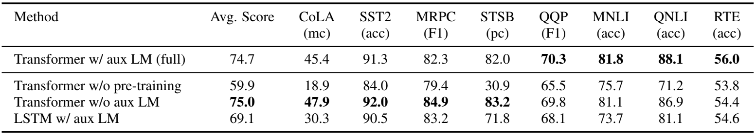
Ablation Studies
The researchers found that adding a LM objective during fine-tuning helps with NLI tasks, and overall with larger datasets.
The researchers also note that replacing the Transformer with a LSTM reduces performance on all datasets except for the MRPC (NLI).

Slide 17
Sources
https://www.cs.ubc.ca/~amuham01/LING530/papers/radford2018improving.pdf
http://nlpprogress.com/english/natural_language_inference.html
https://www.cs.upc.edu/~ageno/anlp/textualEntailment.pdf
https://www.microsoft.com/en-us/download/details.aspx?id=52398
https://towardsdatascience.com/applications-of-zero-shot-learning-f65bb232963f

Slide 18
Improving Language Understanding
by Generative Pre-Training
Mica Haney
Himanshu Sharma
Fanjie Ye

Slide 19
Outline
Introduction and Related Work
Framework
1. Unsupervised Pre-Training
2. Supervised Fine-Tuning
Experiment Results and Evaluation

Slide 20
Introduction
Although it’s important for NLP tasks to reduce the dependency on supervised learning, most deep learning methods require substantial amounts of manually labeled data.
This paper proposed a method which combines unsupervised and supervised learning to learn a universal representation. They achieved it by two-stage training procedure.
This method is based on the Transformer model which has an excellent performance on various NLP tasks and evaluated on four types of NLP tasks. It showed a great improvement on these.

Slide 21
Three Questions
What problem does this paper try to solve?
Why is this problem important for NLP?
How does this method work for solving it?

Slide 22
Related Work
Semi-supervised learning for NLP:
Phrase-level or sentence-level embeddings, which can be trained using an unlabeled corpus, have been used to encode text into suitable vector representations for various target tasks (higher-level semantics than word-level information).
Unsupervised pre-training:
The goal is to find a good initialization point instead of modifying the supervised learning objective.
Auxiliary training objects:
Adding auxiliary unsupervised training objectives is an alternative form of semi-supervised learning.

Slide 23
Framework
Two stages of training:
Unsupervised Pre-Training
Supervised Fine-Tuning

Slide 24
Stage 1: Unsupervised Pre-Training
Use multi-layer Transformer decoder for language modeling.
Applies multi-head self-attention on input.
Position-wise feed forward layers for output. Where: U = Vector of Token W_{e} = Token Embedding Matrix n = Number of Layers W_{p} = Position Embedding Matrix

Slide 25
Stage 2: Supervised Fine-Tuning
Training using label dataset.
Activation from stage 1 fed into linear output layer.
Auxiliary language modeling helps learning by:
Improving Generalization.
Accelerating Convergence.
Optimize objective with weight λ.

Slide 26
Architecture
Transformer
Fine-Tuning

Slide 27
Task-Specific Input Transformer
Textual entailment
Concatenate premise & hypothesis token($) seq. with delimiter in between..
Similarity
Input seq. contain sentence no inherent oderings and process each independently.
Sequence representations are added element-wise.
Q&A and Commonsense Reasoning
Concatenate context document and possible answer with delimiter in between.
Seq. processed independently and then normalized using softmax.

Slide 28
Experiments and Analysis
Results were evaluated over four different tasks:
Natural Language Inference
Question Answering
Semantic Similarity
Classification
Results were obtained with models trained over the BooksCorpus dataset.

Slide 29
Natural Language Inference
NLI is the task of determining whether a pair of sentences are entailed - if the hypothesis sentence can be inferred from the premise sentence.

Slide 30
Question Answering
Question answering is the task of selecting the answer to a question out of multiple presented answers.

Slide 31
Semantic Similarity and Classification
Semantic similarity is the task of determining if two sentences are roughly similar. Classification (in this paper) is the task of determining if a sentence is grammatical or not.

Slide 32
Zero-Shot Analysis
Zero-shot learning is the task of taking a supervised-training model, and testing its performance on completely unseen data.
The stable, steady increase in performance indicates that the Transformer model learns a wide variety of task-relevant functionality.

Slide 33
Ablation Studies
The researchers found that adding a LM objective during fine-tuning helps with NLI tasks, and overall with larger datasets.
The researchers also note that replacing the Transformer with a LSTM reduces performance on all datasets except for the MRPC (NLI).

Slide 34
Sources
https://www.cs.ubc.ca/~amuham01/LING530/papers/radford2018improving.pdf
http://nlpprogress.com/english/natural_language_inference.html
https://www.cs.upc.edu/~ageno/anlp/textualEntailment.pdf
https://www.microsoft.com/en-us/download/details.aspx?id=52398
https://towardsdatascience.com/applications-of-zero-shot-learning-f65bb232963f

